Slide 1
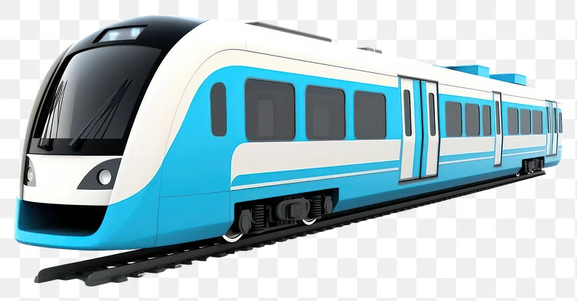

Slide 2






Team Leaders & Members
Bharani Kumar Depuru
Director & Co-Founder at Innodatatics
linkedin.com/in/bharanikumardepuru/
Name: Anand Kishore Kalthuri
linkedin.com/in/anand-kalthuri/
Name: Pavan Kumar
linkedin.com/in/e-pavan-kumar-a4b387281/
AND SOME MORE PEOPLE

Slide 3
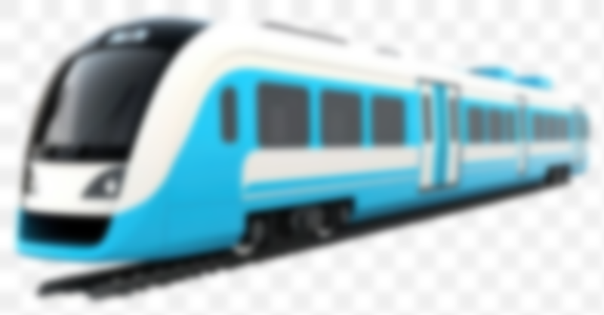
Contents
Business Problem
Business Constraints
Business Overview and Scope
Project Architecture
Data Dictionary
Exploratory Data Analysis
Business Objective
Data Visualization
Notes:
Change

Slide 4

Business Problem
Business problem: In the competitive landscape of tendering, securing contracts relies significantly on offering competitive pricing. However, accurately determining the optimal bid amount can be challenging, especially without insights into competitors' pricing strategies. Consequently, our client faces the dilemma of losing tenders due to overpricing or risking profit margins by underpricing.
Business Objective: Maximize the win rate of Tender contracts.
Business Constraint: Minimizing the potential loss of profit margins through the development of a data-driven pricing strategy.

Slide 5
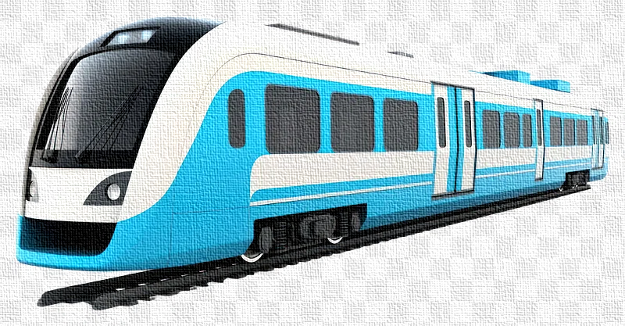
Project Overview and Scope
Business Success Criteria: Achieving a higher tender win rate and maintaining competitive profitability through accurate competitor price predictions, with a target increase of at least 10%.
ML Success Criteria: Achieve a minimum accuracy of 90%.
Economic Success Criteria: Enhancing profit margins by at least 5% through more accurate pricing strategies and reduced bid rejections.

Slide 6
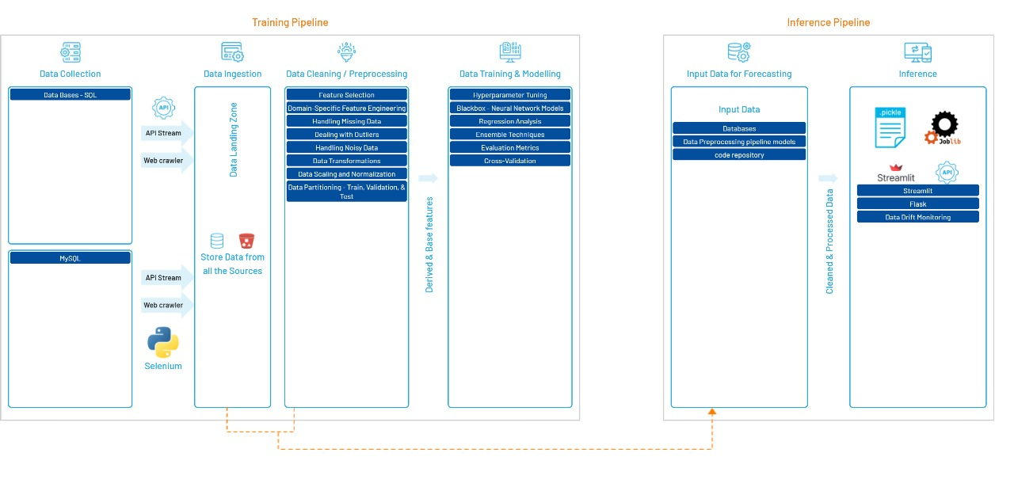
Project Architecture

Slide 7

Data Dictionary
Tender no: The unique identifier or reference number assigned to each tender. Type: Alphanumeric
Railway Location: The geographical location or site where the railway project or procurement is based. Type: Categorical
Zone: The railway zone under which the tender falls. Indian Railways is divided into various zones. Type: Categorical
Division: The division within the railway zone where the project or procurement is located. Type: Categorical
Date of opening: The date on which the tender is opened for bidding or evaluation. Type: Date
Nature: The type or nature of the work or service being tendered. It could be supply, execution, supervision, etc. Type: Categorical
Awarded to: The name of the company or entity to which the tender was awarded. Type: Categorical
Basic: The base cost or amount for the tendered work or items. Type: Numeric
Qty: The quantity of items or scope of work covered under the tender. Type: Numeric
Category: The classification or type of goods or services being procured (e.g., specific types of railway materials). Type: Categorical
Customer_1 to Customer_12: These fields likely represent different customer entities or stakeholders related to the tender. Each field could denote a specific customer's bid price or their participation status. Type: Numeric (bid prices)

Slide 8

Exploratory Data Analysis [EDA]
Statistical Insights
Business Insights
Descriptive Statistics
Mean, Median, Mode: Measures of central tendency.
Standard Deviation, Variance: Measures of spread.
Minimum, Maximum, Range: Measures of extremity.
Frequency Distribution
Frequency Count: Number of occurrences of each unique value.
Correlation Analysis
Correlation Coefficient: Measures the strength and direction of the relationship between two variables.
Customer Insights
Customer Segmentation: Identifying distinct groups of customers based on their behaviours, preferences, or demographics
Operational Insights
Process Optimization: Identifying inefficiencies in business processes and suggesting improvements.
Product Insights
Product Development: Understanding customer needs and preferences to guide product development.
Financial Insights
Profitability Analysis: Evaluating the profitability of different products, services, or business units.
Notes:
EDA is used for seeing what the data can tell us before the modeling task.
Change

Slide 9

Data Preprocessing
Type Casting: Converting data from one type to another (e.g., from strings to integers or floats).
Purpose: Ensures that each feature has the correct data type for analysis and modelling.
Handling Duplicates: Identifying and removing duplicate rows in the dataset.
Purpose: Eliminates redundancy and potential bias in the data.
Zero Variance Features: Features that have the same value for all samples.
Purpose: These features do not provide any useful information for modelling and can be removed.
One-Hot Encoding: Converting categorical variables into a series of binary columns.
Purpose: Makes categorical data suitable for machine learning algorithms which require numerical input.
Imputation: Filling missing values in the dataset.
Purpose: Handles missing data which can cause issues in analysis and modeling.
Standardization: Scaling features to have a mean of 0 and a standard deviation of 1.
Purpose: Ensures that all features contribute equally to the analysis, especially important for algorithms like SVM or K-means.
Notes:
Keep observations

Slide 10
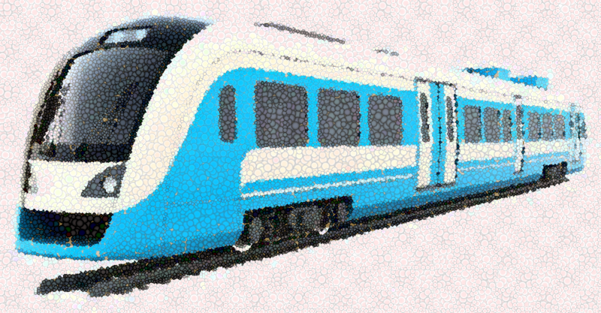
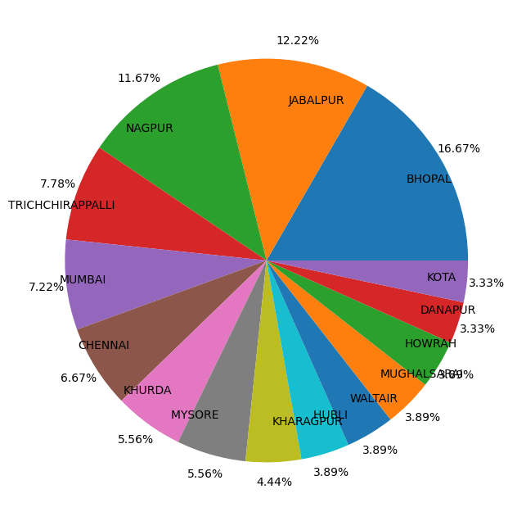
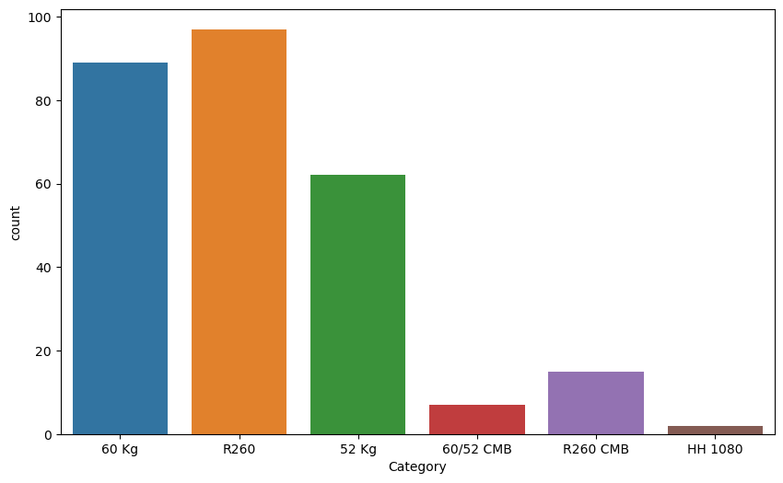
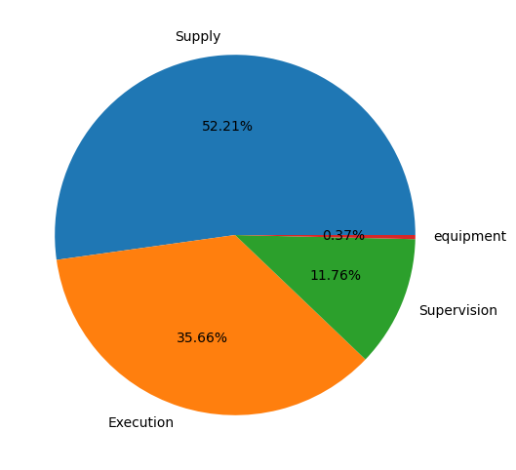
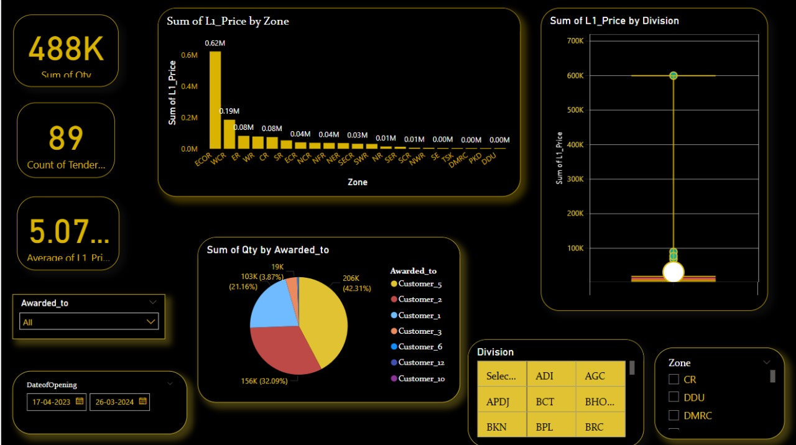
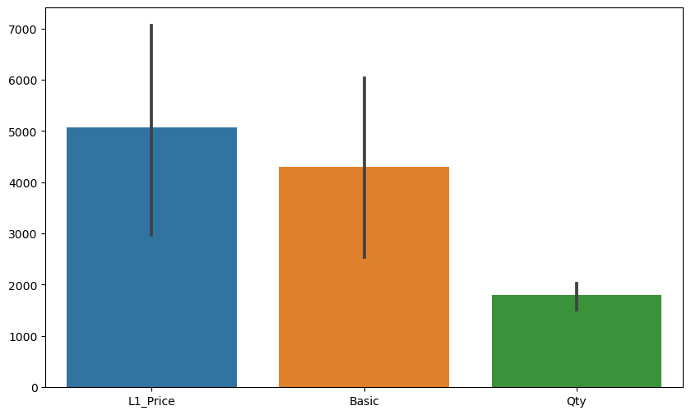
Data Visualization
Notes:
Add graphical

Slide 11


